Slide 1
When Does Model-Based Control Pay Off?
A paper review presentations

Slide 2
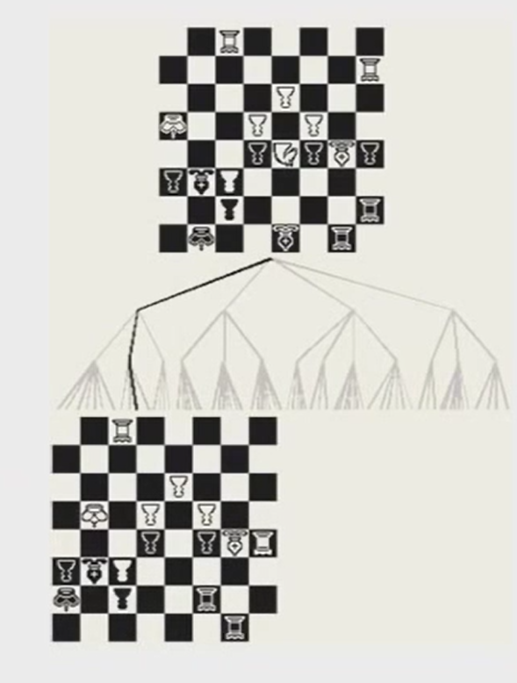
How we make decisions?

Slide 3
A walk in history
Eugenics Movement
Behaviorism (S-R): that instrumental behavior reflected the emergence of an associative structure, wherein representations of a stimulus context during learning became, with increasing experience, more strongly connected to a mechanism generating behavioral responses
Cognitive map:
Tolman Experiments
Goal directed-habitual

Slide 4
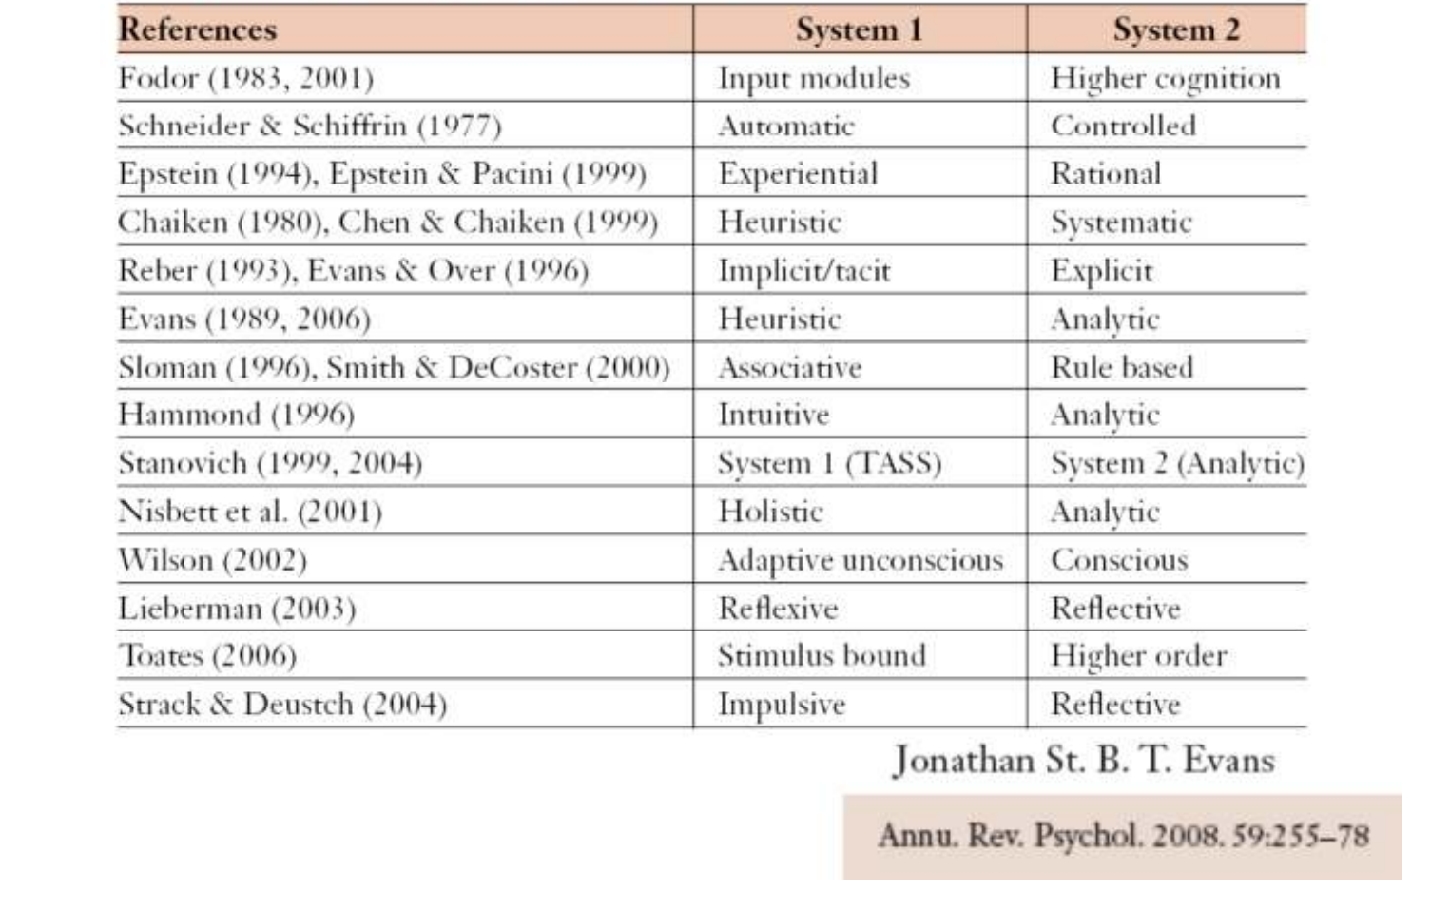
Two system many names

Slide 5
Model-free and model-based

Slide 6
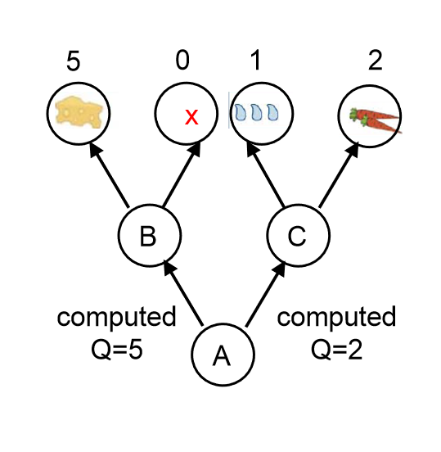
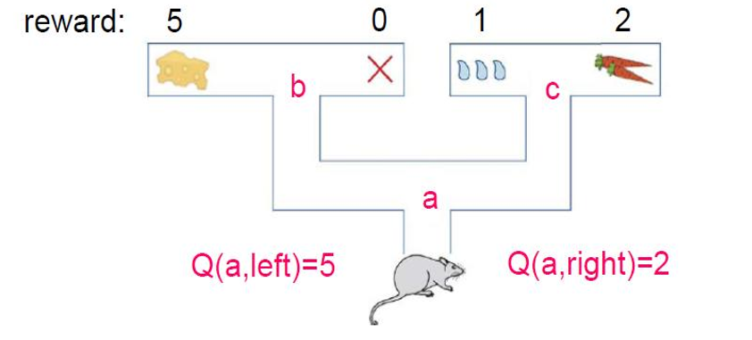
Model-based decision making

Slide 7
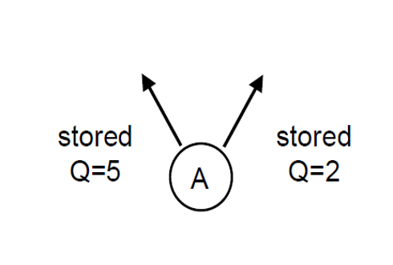
Model-Free decision making

Slide 8
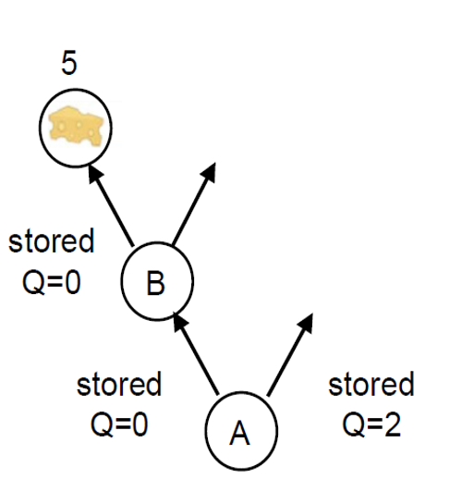
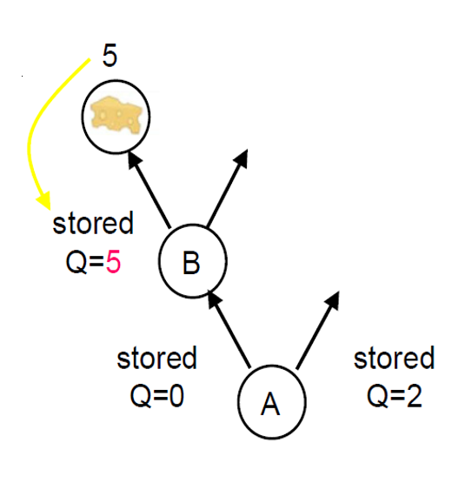
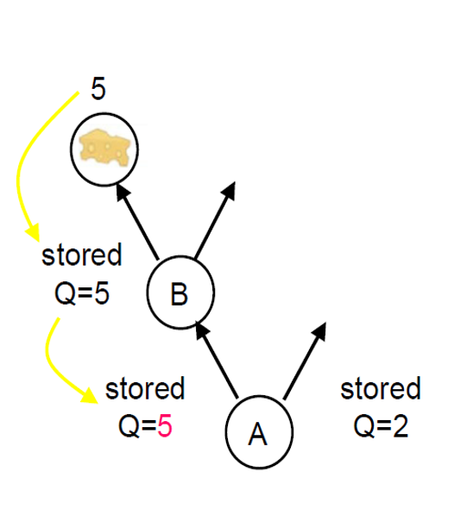
Model-Free decision making

Slide 9

Comparison between the two system
Model-free:
Computationally cheap
Not statistically optimal
$$V\left(x\left(t\right)\right)=r\left(t\right)+r\left(t+1\right)+ …=r\left(t\right)+V\left(x\left(t+1\right)\right)$$
$$δ=r\left(t\right)+V\left(x\left(t+1\right)\right)−V(x\left(t\right))$$
Model-based:
cognitively demanding.
Could be optimal
Tradeoff between accuracy and computational demand plays important role in the arbitration
between the two strategies.
untested

Slide 10
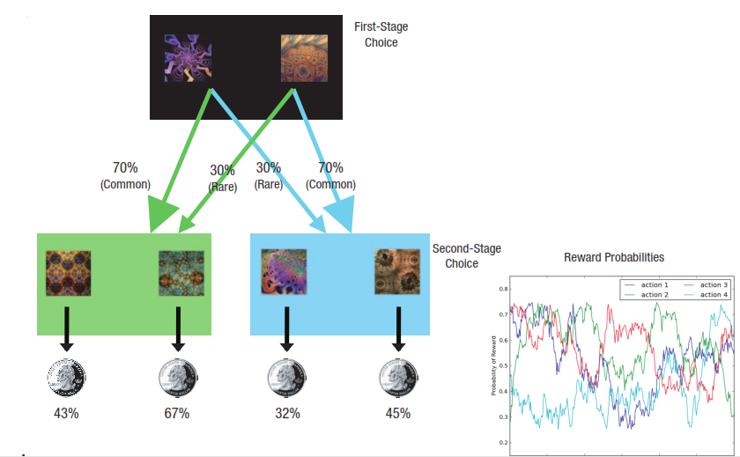
Investigating Two systems in humans
Currently, the dominant method that aims to dissociate mechanisms of behavioral control within the reinforcement learning framework is the “two-step task”.
1. It consist of two step of decision making, obviously!!!
2. In each step there is two available action
3. The second step action can be rewarding
4. The reward probability came from 4 distinct Gaussian random walks

Slide 11
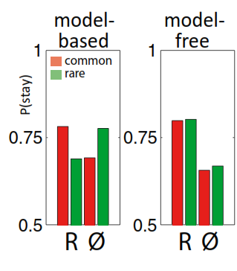
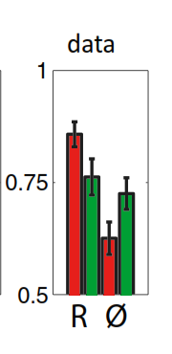
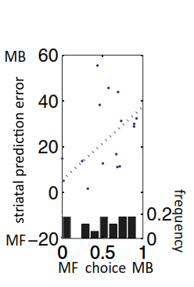
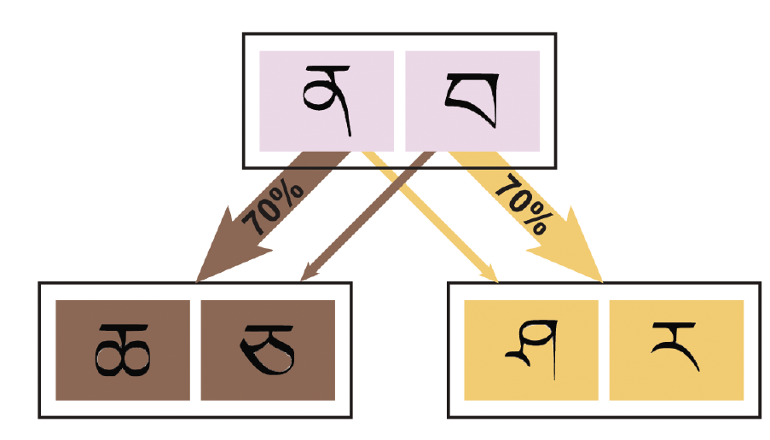
P(stay)

Slide 12
Reinforcement learning modelling

Slide 13

notations
$$s_{A}=first stage state s_{B,C}=second stage state$$
$$a_{A}=first stage action a_{B}=second stage action$$
$$on trial t→s_{1,t}:first stage state, s_{2,t}:second stage state$$
$$on trial t→a_{1,t}:first stage action , a_{2,t}:second stage action$$
$$on trial t→r_{1,t}:first stage reward , a_{2,t}:second stage reward$$
Goal: find state-action value function

Slide 14

Model-free learning
$$Q_{MF}\left(s, a \right)=Q_{MF}\left(s,a\right)+αδ_{i,t}e_{i,t}(s,a)$$
Where
$$δ_{i,t}=r_{i,t}+Q_{MF}\left(s_{i+1,t},a_{i+1,t}\right)−MF\left(s_{i,t},a_{i,t}\right)$$
With eligibility trace
$$e_{i,t}\left(s_{i,t},a_{i,t}\right)=e_{i−1,t}\left(s_{i,t},a_{i,t}\right)+1(with λ decay)$$

Slide 15

Model-based learning
$$Q_{MB}\left(s_{A},a_{j}\right)=P\left(s_{B} | s_{A},a_{j}\right)\max{Q_{MF}\left(s_{B}, a\right)+P\left(s_{C} | s_{A},a_{j}\right)\max{Q_{MF}(s_{C}, a)}}$$

Slide 16

Mixture model
$$Q_{net}\left(s_{A},a_{j}\right)={wQ}_{MB}\left(s_{A},a_{j}\right)+{(1−w)Q}_{MF}\left(s_{A},a_{j}\right)$$
With decision rule:
$$P\left(a_{i,t}=a | s_{i,t}\right)=\frac{exp⁡\left[{βQ}_{net}\left(s_{i,t},a\right)\right]}{\sum_{a′}{\exp\left[{βQ}_{net}\left(s_{i,t},a′\right)\right]}}$$

Slide 17

Parameters
$α$: learning rate
$β$: inverse temperature
W: weighting parameter

Slide 18
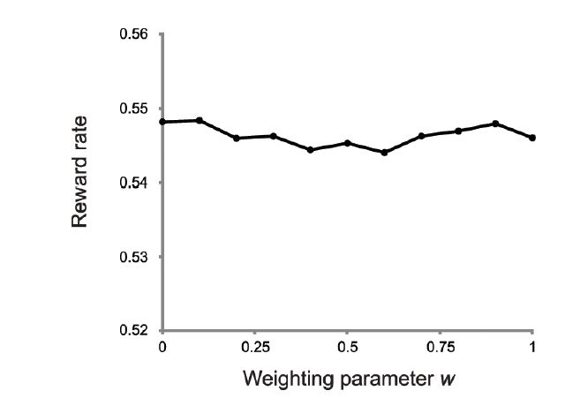
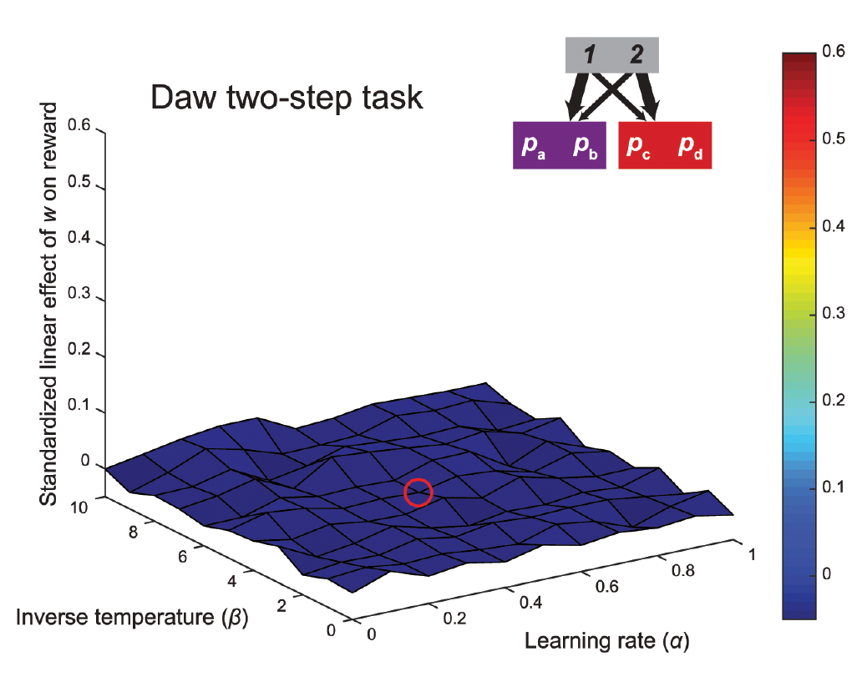
Original task
$$Q_{net}\left(s_{A},a_{j}\right)={wQ}_{MB}\left(s_{A},a_{j}\right)+{(1−w)Q}_{MF}\left(s_{A},a_{j}\right)$$
$$\text{params}\text{ = }\text{polyfit}\text{(}\text{zscore}\text{(}\text{ws}\text{), }\text{zscore}\text{(}\text{rewardrate}\text{), }\text{1}\text{)}$$

Slide 19
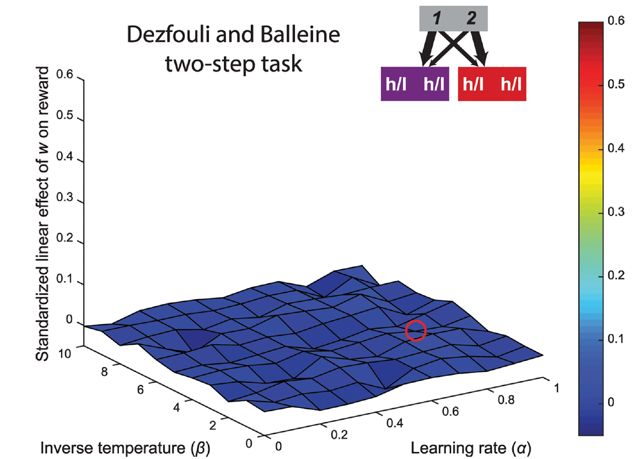
Dezfouli and Balleine version

Slide 20
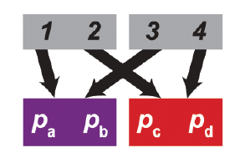
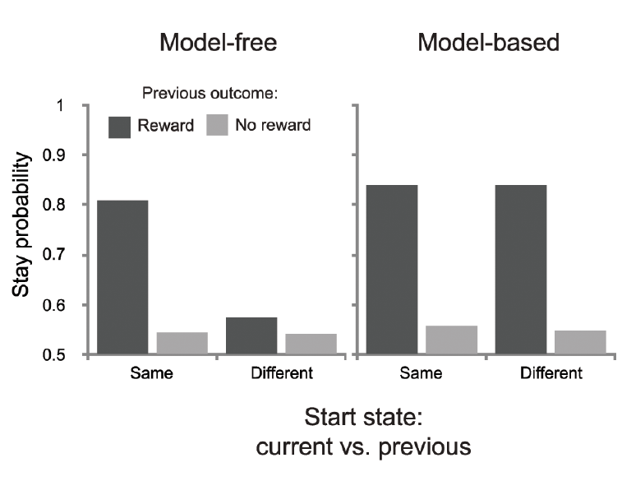
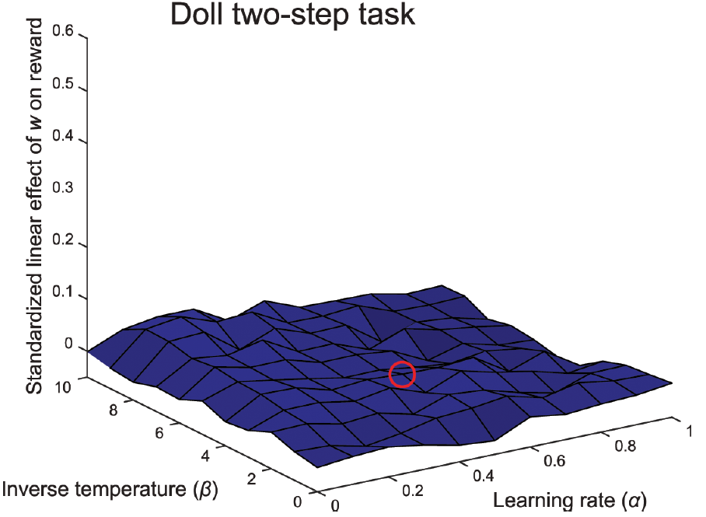

Doll version
$$\text{Here}\text{, }\text{it} \text{is} \text{assumed} \text{that} \text{only} \text{model}\text{-}\text{based} \text{learners} \text{use} \text{the} \text{implicit} \text{equivalence} \text{between} \text{the} \text{two} \text{firststage} \text{states}\text{, }\text{and} \text{can} \text{generalize} \text{knowledge} \text{across} \text{them}\text{.}$$

Slide 21
Factors contributing to the absence of the trade-off

Slide 22
Distinguishability of second-stage probabilities
The difference between model-based and model-free strategies only carries consequences for the first stage.

Slide 23
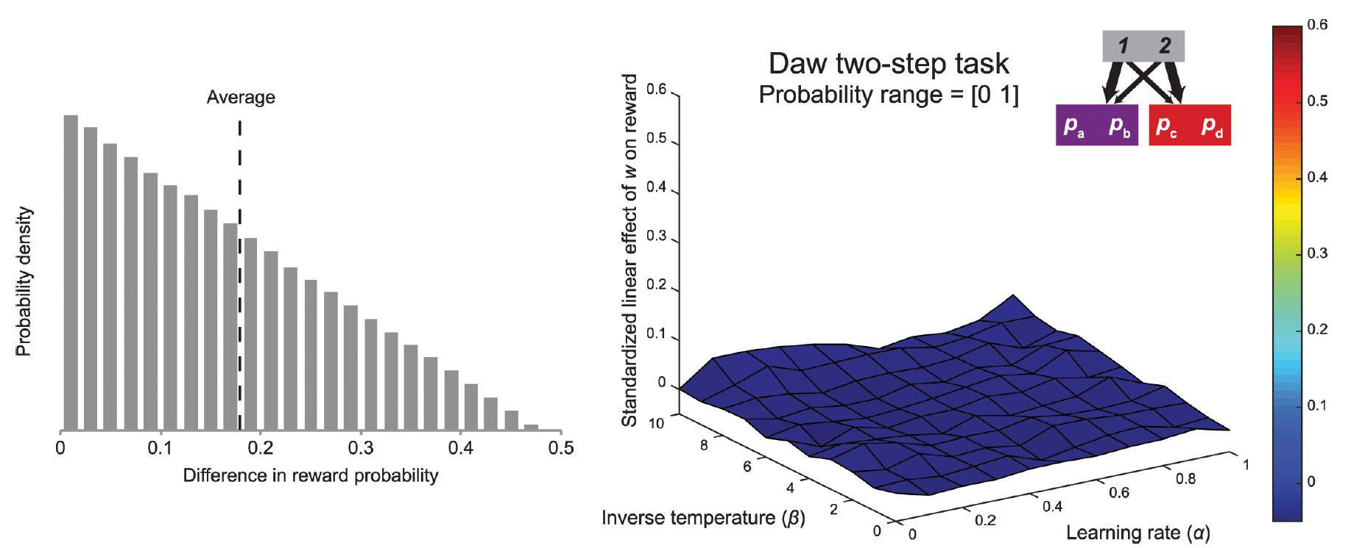
Distinguishability of second-stage probabilities

Slide 24
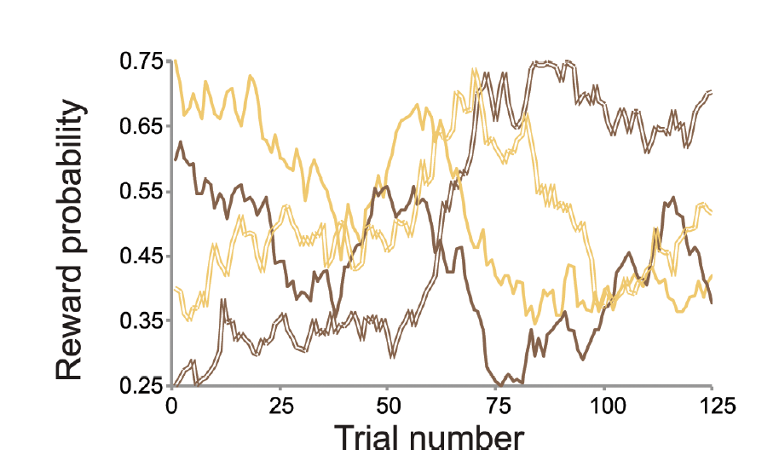
drift rate
The changes in the reward probabilities might be too slow or too fast.
If too slow, model-free learning can adapt to these values at a rate that is proportional to the rate of change over time.
If too fast, model-based system never accurately reflects the values of the second-stage actions

Slide 25
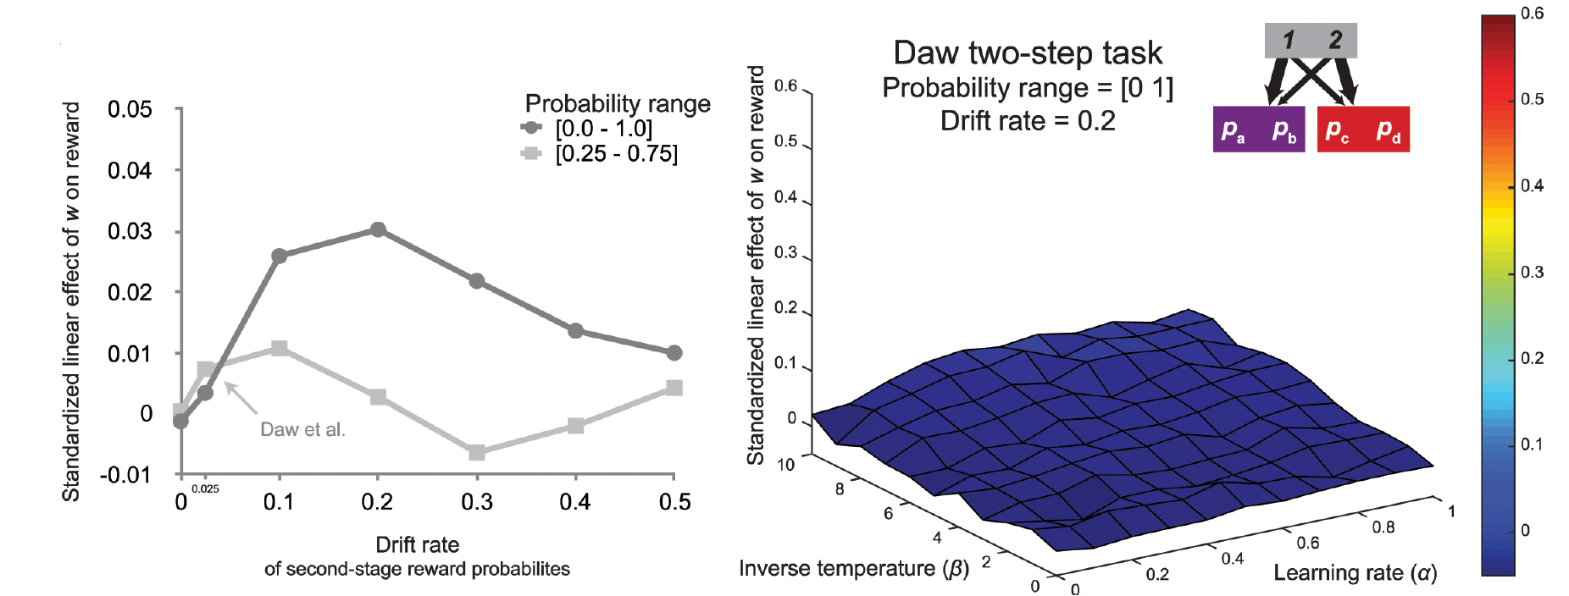
drift rate

Slide 26
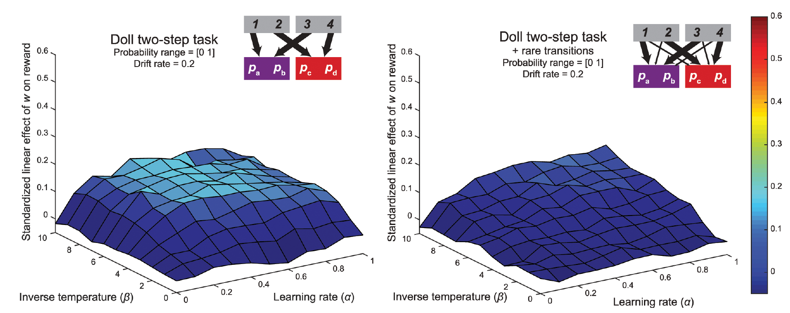
Deterministic transition structure

Slide 27
One choice in second stage
the advantage of model-based control over model-free control is approximately bounded by the difference between the maximum value of all actions available in one second-stage state and the maximum value of all actions available in the other second-stage state.
The average difference between any two reward probabilities within a state was equal to 0.33, whereas the average difference between the maximal reward probabilities of the two states was 0.27.

Slide 28
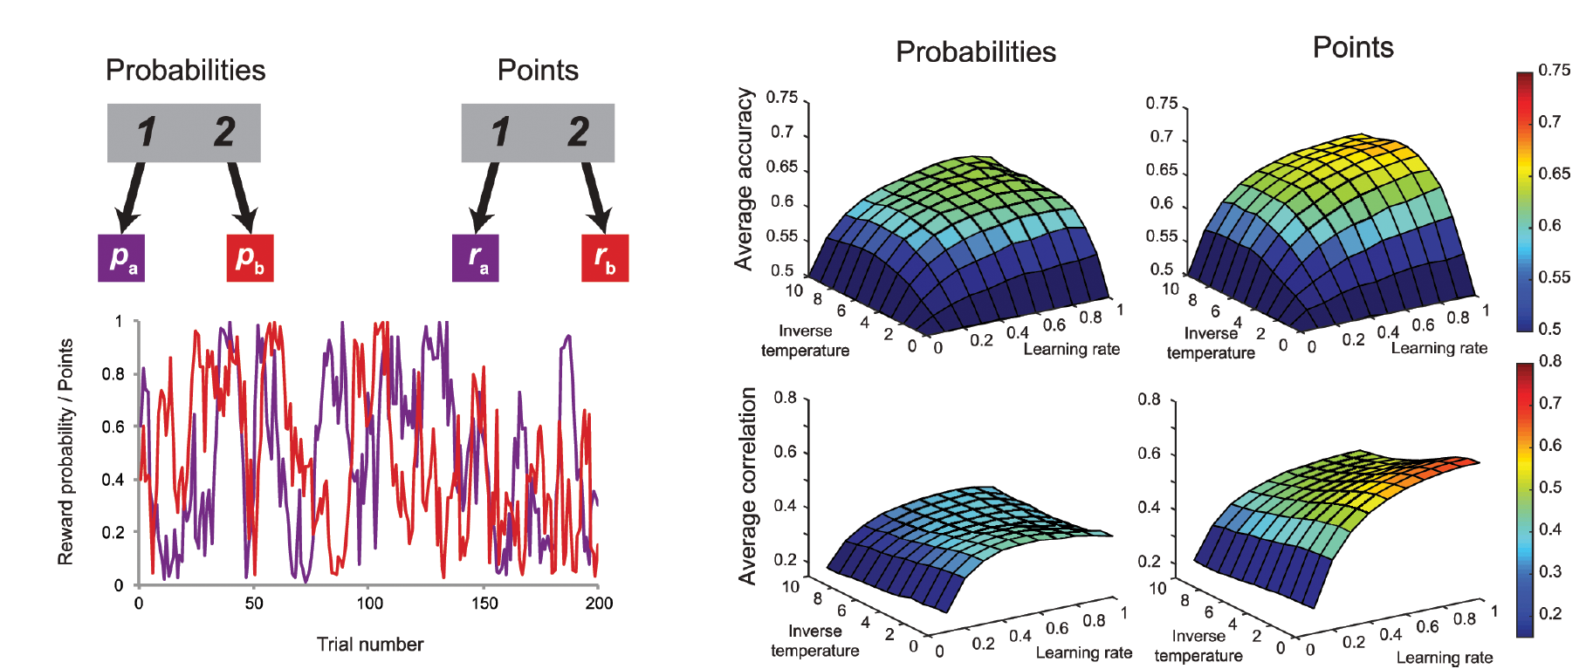
Informativeness of an observation
It might be high amount of ambiguity associated with each observation contributes to the absence of the accuracy-demand trade-off in the two-step task.

Slide 29
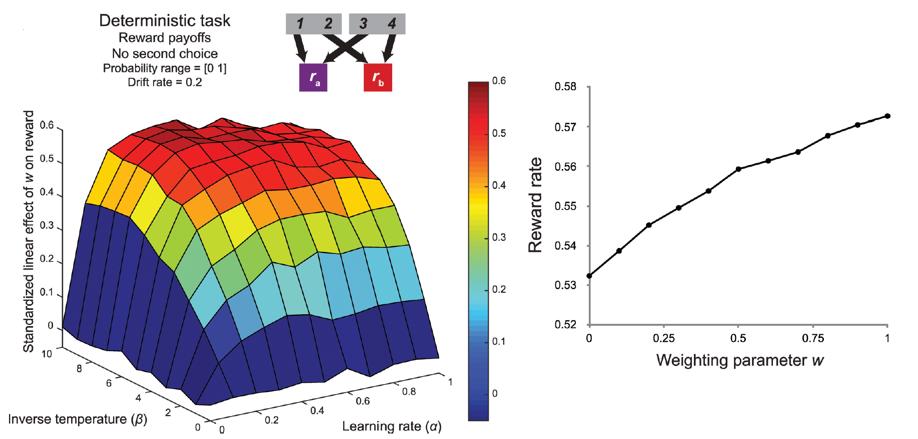
Summery of these factor
Distinguishability of second-stage probabilities
Drift rate
Deterministic transition structure
One choice in second stage
Informativeness of an observation

Slide 30
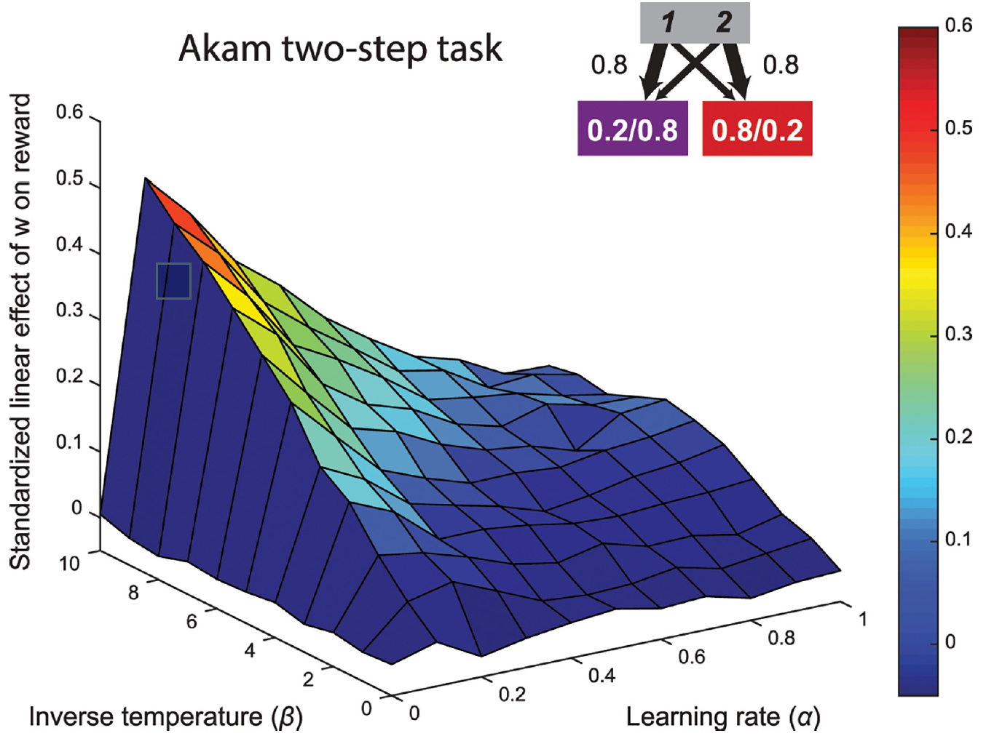
Akam version

Slide 31
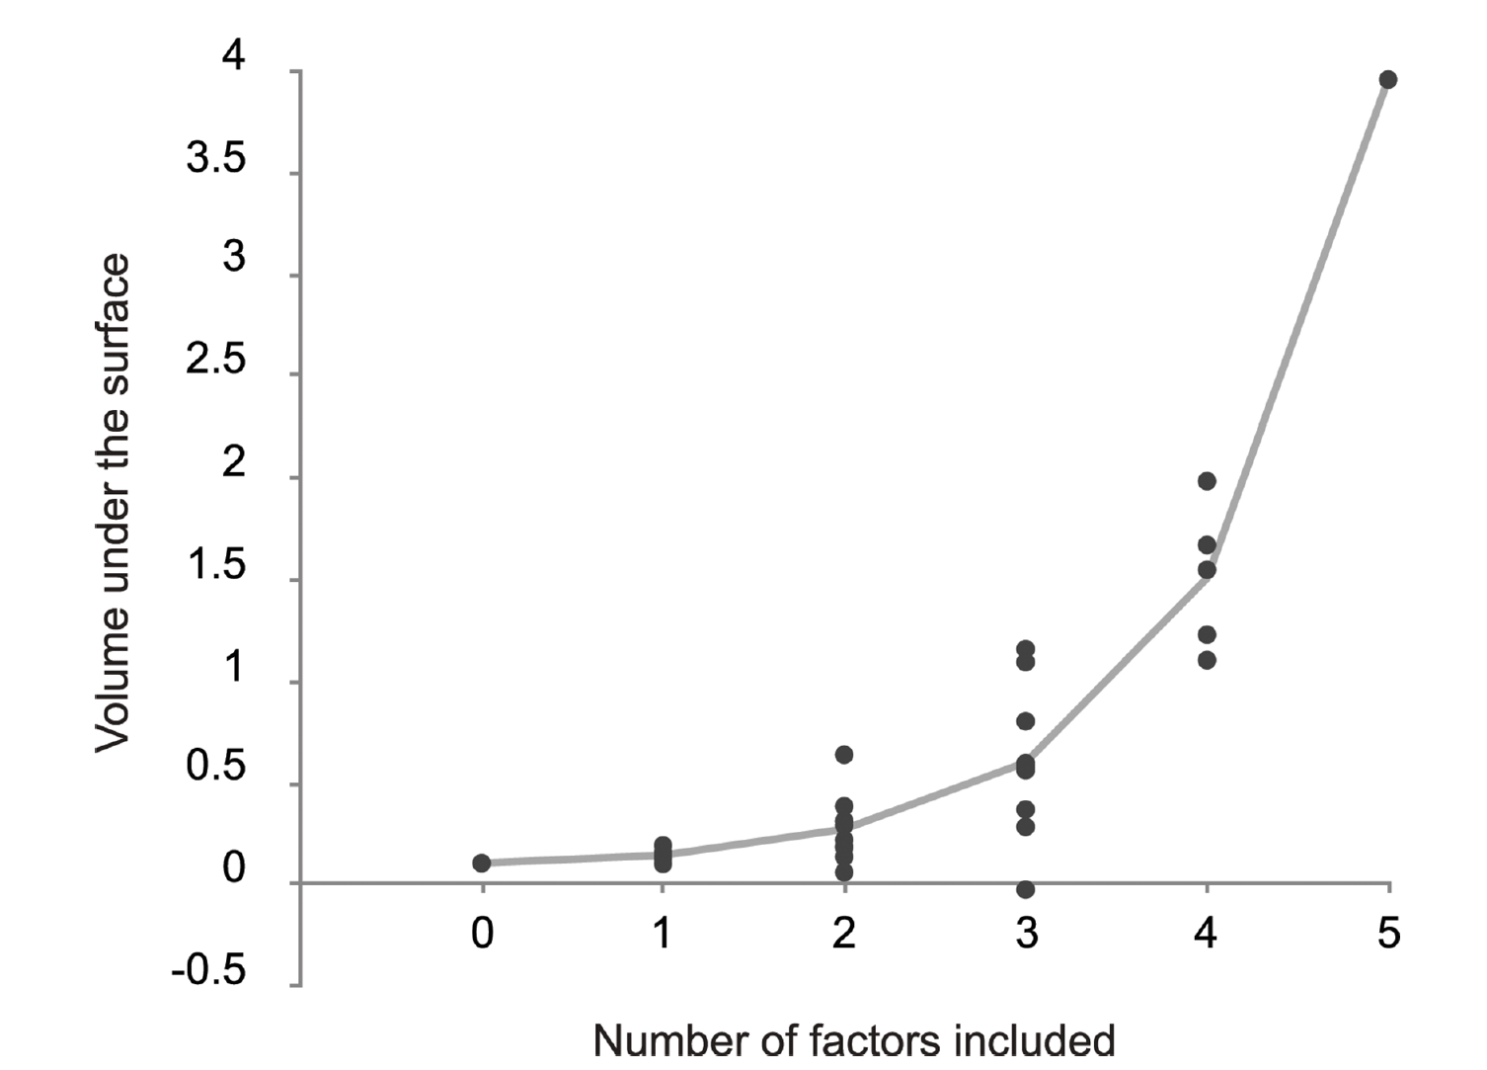
Volume under the surface for all 32 tasks generated by the 5 binary factors

Slide 32
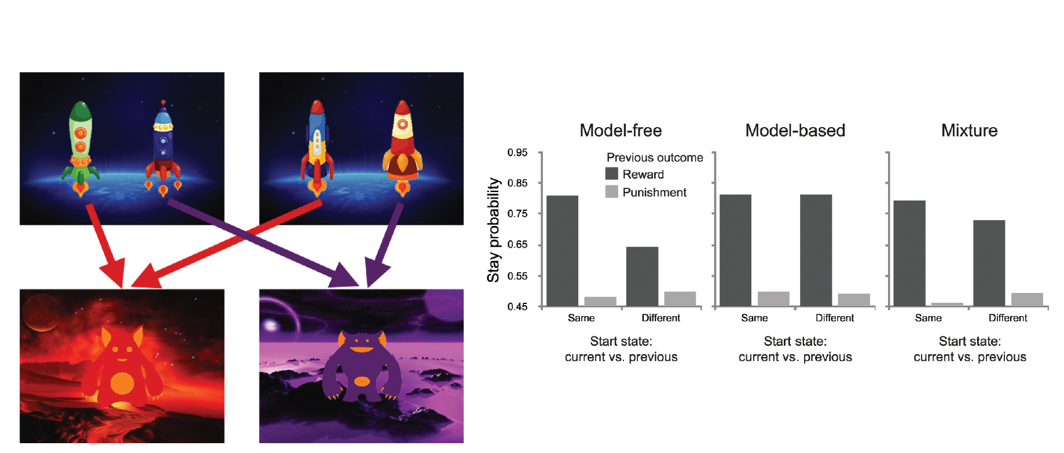
The novel task

Slide 33
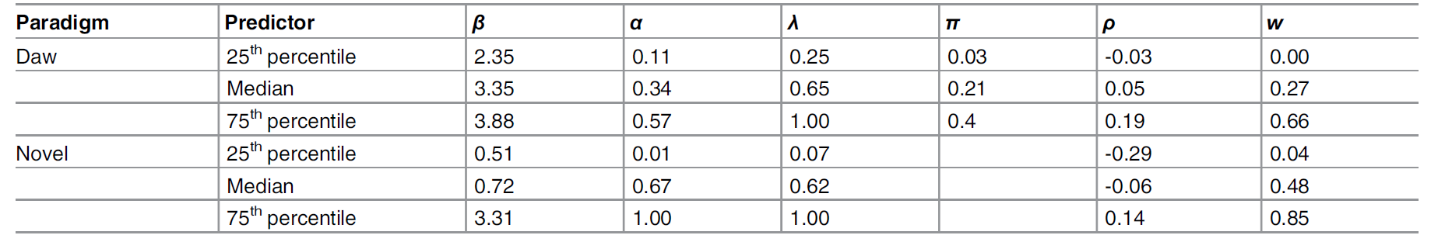
Model fitting

Slide 34
Putting it all together

Slide 35
So…
The distinction between planning and habit lies at the core of behavioral and neuroscientific research, and plays a central role in contemporary dual process models of cognition and decision making.
Modern reinforcement learning theories formalize the distinction in terms of model-based and model-free control bringing new computational precision to the long-recognized trade-off between accuracy and demand in decision making.

Slide 36
What was the aim of this paper?
the hallmark task for dissociating model-based and model-free control—the Daw two-step paradigm do not embody a trade-off between accuracy and demand across a wide range of parameter space.
This paper developed developed a novel variant that shows a strong relationship between model-based control and reward both in simulations and in experimental data by eliminating the meddling factors.

Slide 37
Summery of these factor
Distinguishability of second-stage probabilities
Drift rate
Deterministic transition structure
One choice in second stage
Informativeness of an observation

Slide 38
trade-off between model-based and model-free control
That novel two-step task elicited greater average model-based control in our participants than the original Daw two-step task.
This result is one of the first pieces of behavioral evidence suggesting an adaptive trade-off between model-based and model-free control.
This may indicate that participants store “controller values” summarizing the rewards associated with model-based and model-free control.
It is possible the presence of deterministic transition structure or the introduction of negative reward induced increased model-based control triggered by a Pavlovian response to these types of task features.

Slide 39
Way we could find model-based effect on the original version?
One possibility is that, in the absence of a reliable signal from the environment, behavior on this task reflects participants’ belief about how model-based control relates to reward maximization in the real world.
Another possibility is that the extensive training of participants on the transition structure of the experiment induces them to assume they should be using it during task performance.

Slide 40
A new way the look for model-based system in the brain
The reward prediction errors of the model-free system correlated with signal in the striatum.
However, despite the distinct computational features of the two systems, the model-based reward prediction errors recruited a similar, indistinguishable, region of the striatum.
This paper simulations may shed light on this surprising finding, insofar as model-based system was not appropriately incentivized.

Slide 41
Some Questions
how does the brain adapt its allocation between model-based and model-free control?
At what time scale is this possible?
What is the appropriate computational account of arbitration between the two systems?
What neural regions are involved in determining whether one should exert more model-based control?

